Slide 1
Swole Patrol
Huzaifah Aamir
Rebecca Bennett
Danny Lopez
Mary Claire Hodge
Jeremy Balemala

Slide 2
Problem & Solution
Have you ever wanted to…
  start working out but had no idea where to begin or too embarrassed to ask?
  start working out but can’t find motivation?
  start working out but cannot afford a personal trainer or gym membership?
  change your same old workout routine?
  have competitions with friends or ask questions about workouts?
  have a system that you can find and keep track of your workouts as well as count calories?
Our solution:
  Swole Patrol
    A workout application that gives a person different workouts for particular parts of the body
      Randomized workouts or select from long list of workouts
      All workouts will have instructions, pictures, and a video on how to perform said workout
    A workout application with a forum for competitions and to ask questions
    An application that allows you to count your calories as well
  One single application for exercising and eating instead of 2 or 3

Slide 3
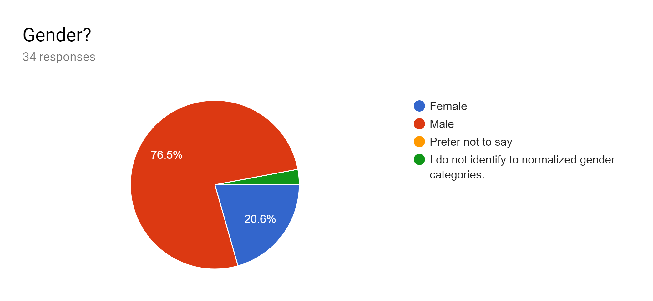
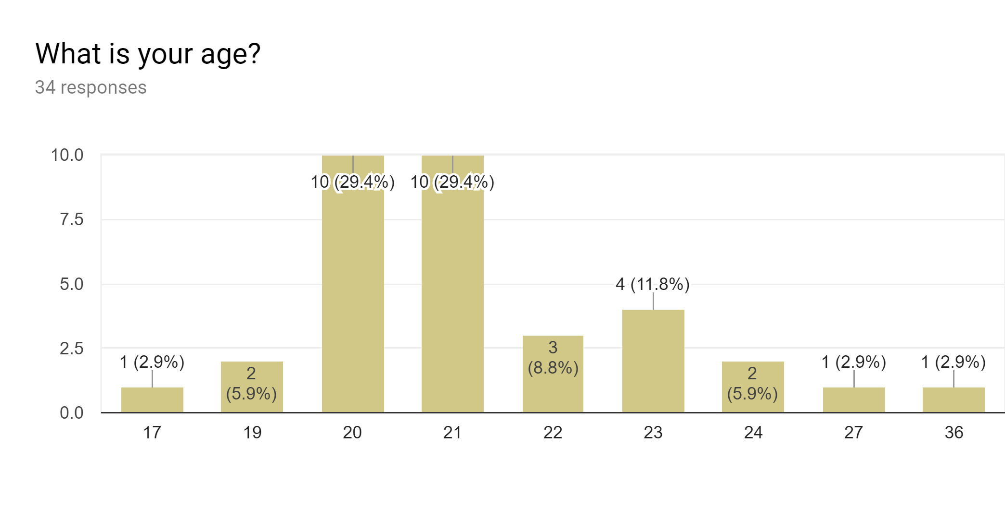
Demographics
The users we want to use our applications are beginners and experts at exercising.
We Surveyed people on campus, so majority of our sample size are college students.
The average age of males was around 20-21
The average age for females was around 22

Slide 4
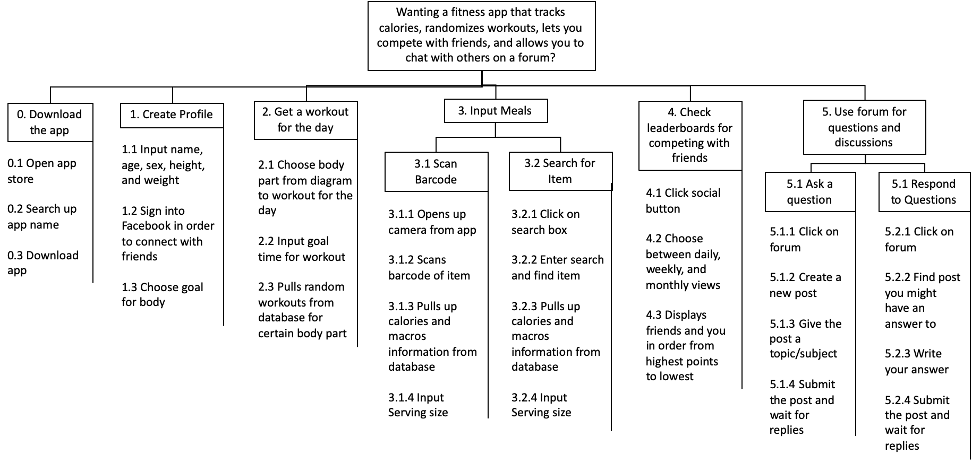

Slide 5
Interpretative Evaluation of Current Available Apps
Researched and evaluated the top fitness apps for 2019.
Focused on the top two fitness apps: Aaptiv and Fitbod.
Aaptiv had a social media aspect, but so many workout options it was overwhelming.
Fitbod randomized workouts and was easy to use, but no social media or sharing options.
Solution: Create one app that is easy to use and has social media built into it.

Slide 6
Website link
https://discopenguin12.github.io/HCI-2BOrNot2B/

